Slide 1



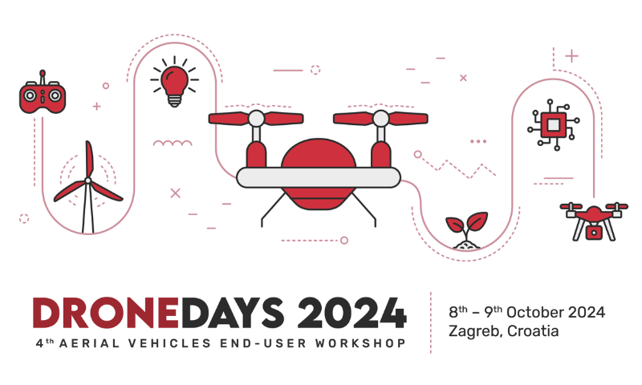


Multi-sensor Multi-object Tracking System
DRONEDAYS 2024
Zagreb, 10.10.2024.

Slide 2
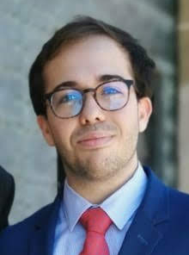
Who am I?
Hi, my name Javier Gil Avilés, from Seville, Spain.
I received a bachelor’s degree in Electronic, Robotic, and Mechatronic Engineering from USE in 2023.
I’m currently finishing a master’s degree in Electronic, Robotic, and Automatic Engineering from USE in 2024.
I have 1 year of work experience in the development of multi-sensor, multi-obstacle tracking systems, inside GRVC Labs.
I have also spent 1 year working at FlyROS on the AeroSTREAM project.
Fun fact: I like memes, movies and videogames. :)

Slide 3
Who is flyROS?
A Spanish SME founded in November 2019 by two researchers in robotics from the University of Seville (GRVC Robotics Lab)
Each one with 15+ years of expertise in the field of Aerial Robotics
Acquired through numerous and diverse European and National Projects
With the mission of delivering cutting-edge robotic solutions to real-life industry

Slide 4
Who is Robotic Labs GRVC?
The Robotics, Vision and Control Laboratory (GRVC) includes over 50 members, with 10 professors from the Universities of Seville and Pablo de Olavide, alongside researchers and engineers. GRVC is recognized internationally in aerial robotics and unmanned aerial systems, combining research, technology development, and industry collaboration.
Led by Anibal Ollero, GRVC secured the ERC Advanced Grant GRIFFIN, focusing on new aerial robotic systems with advanced flying, perching, and manipulation capabilities.
In the last 5 years, GRVC members published over 170 works, including 60 papers in SCR Journals, authored or edited 20 books, and received 18 national and international awards. GRVC has produced 16 theses, 6 of which have won awards.

Slide 5

Training steps
Transform ADS-B tracks from global to local
Track Cube1 from its ADS-B data using Kalman Filter
Create a list to track all 3 cubes at the same time
Strengthen the multitracker (random disappearance, low-pass filter, ...)
Add LIDAR measurement using a driver to get tracks
Matching of LIDAR tracks with obstacles in the list
New matrix in Kalman Filter for LIDAR tracks
Final testing and debugging
GitHub:
https://github.com/Javgilavi/multitracker_sim_ws Branch: bones
git clone --single-branch --branch <branch_name> <repo_url>
Ask for any question or error !!!

Slide 6
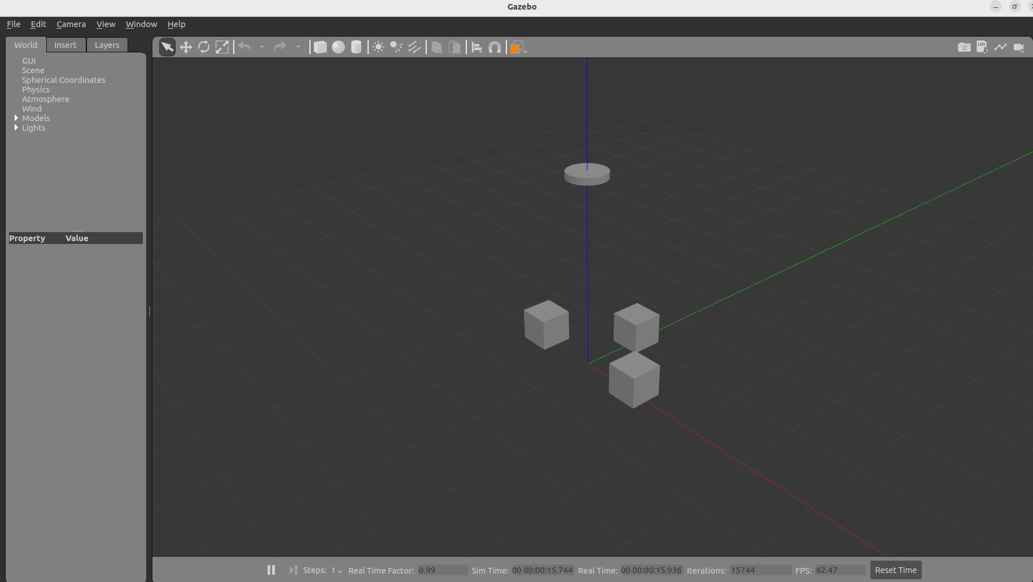
GAZEBO Simulator for the training
Easy environment to develop and test our tracking system.
Sensors: ADS-B and LiDAR.
Drone
Obstacles

Slide 7
GAZEBO Simulator for the training
How to start simulator:
Topics:
Compile the workspace: colcon build
Source the program: source install/setup.bash
Run launcher: ros2 launch drone_sim drone_world_launch.py
/drone/state: Publishes the state of the drone with type Adsb.msg. See inside “sim_msgs”.
/cube/state: Publishes the state of the cubeswith type Adsb.msg.
/drone/laser/scan: If the LIDAR is used, it publishes the sensor data in PointCloud format.

Slide 8
GAZEBO Simulator for the training
Nodes for cube and/or drone movement:
Random xy movement of the 3 cubes with
ros2 run drone_sim cube_mover
Random xy movement of the drone with
ros2 run drone_sim drone_mover
LET’S SEE RESULT IN RVIZ!!!

Slide 9
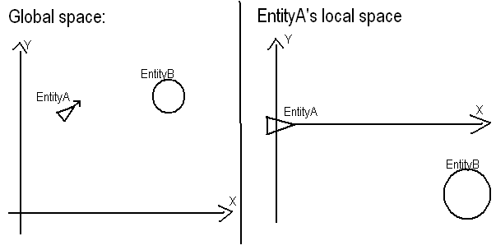
1. Transform global to local
Easy first step
ADS-B data from Cube1 is referred to the origin axis of GAZEBO.
Transform them relative to the drone state
State:
Position:
X
Y
Z
Orientation:
X
Y
Z
W
Velocity:
X
Y
Z

Slide 10
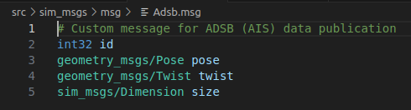
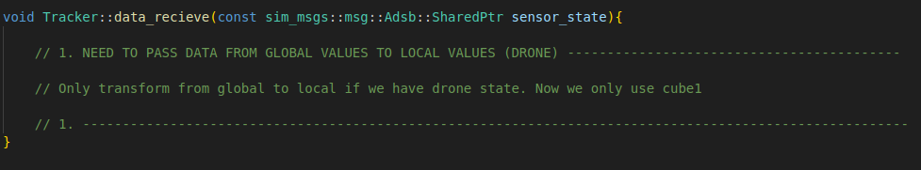
1. Transform global to local
State:
Position:
X
Y
Z
Orientation:
X
Y
Z
W
Velocity:
X
Y
Z
Ask for any question or error !!!

Slide 11
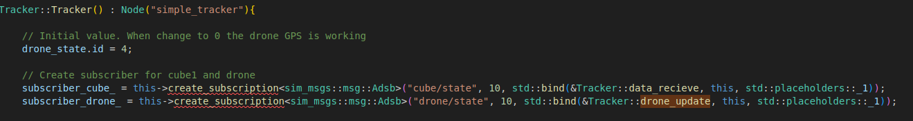
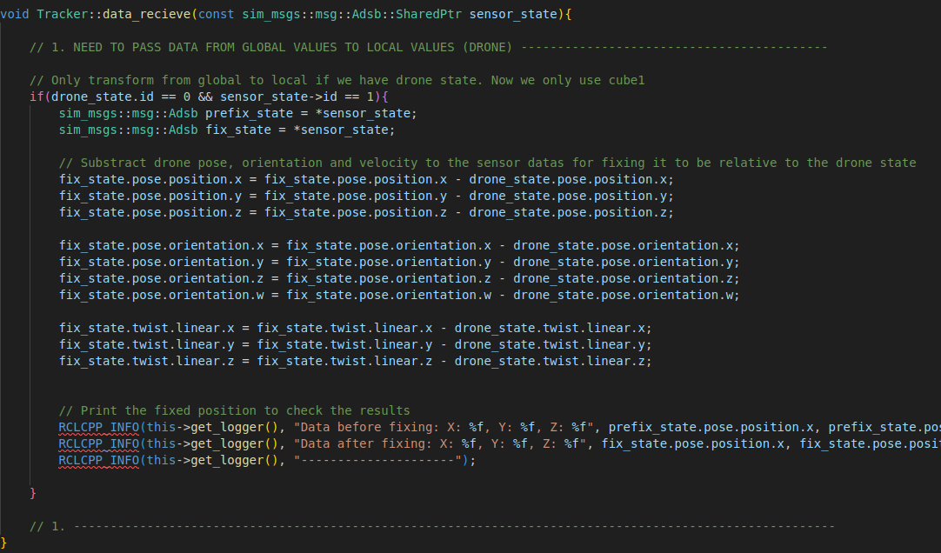
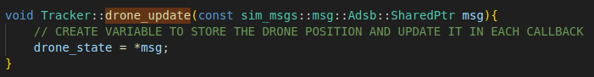
1. Transform global to local - Solution
GitHub:
https://github.com/Javgilavi/multitracker_sim_ws Branch: bones_local
Ask for any question or error !!!

Slide 12
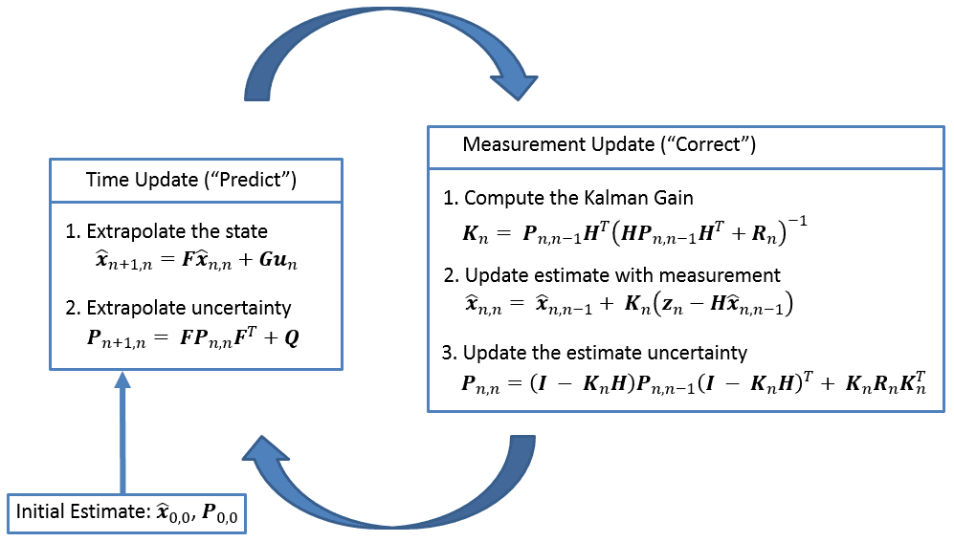
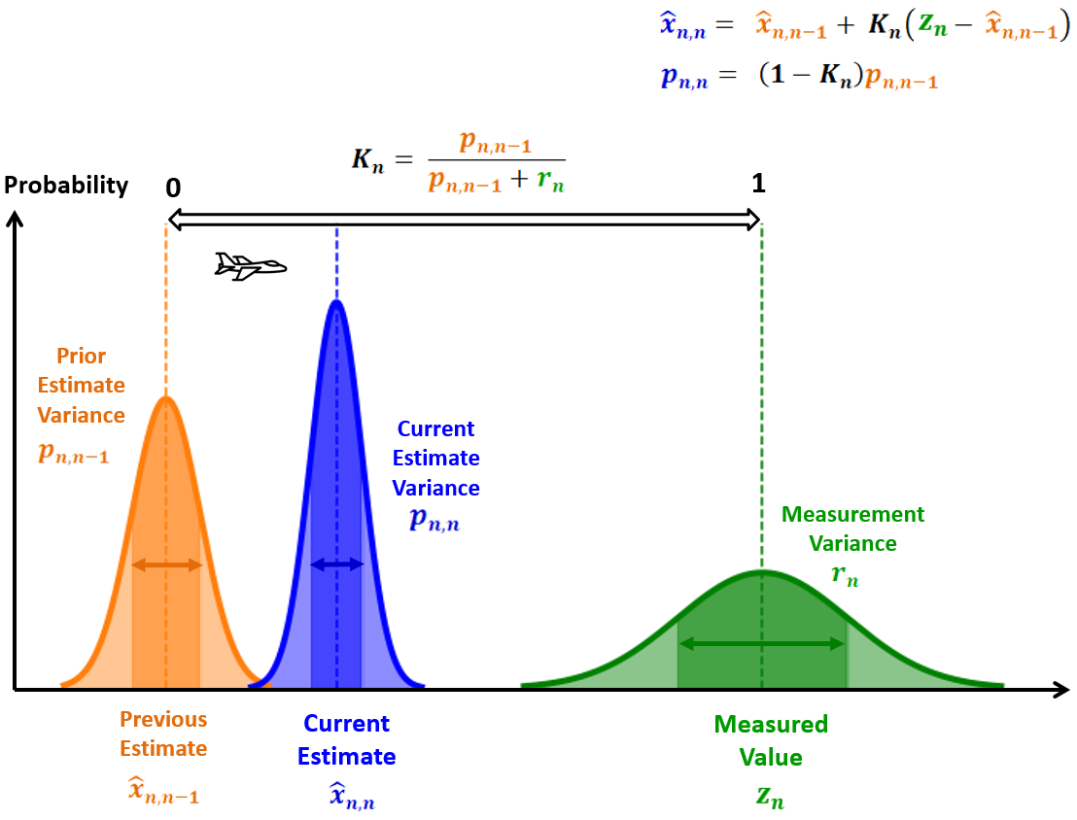
2. Track one obstacle with ADS-B
Use Kalman Filter for prediction and updating the state of the tracking obstacle.

Slide 13
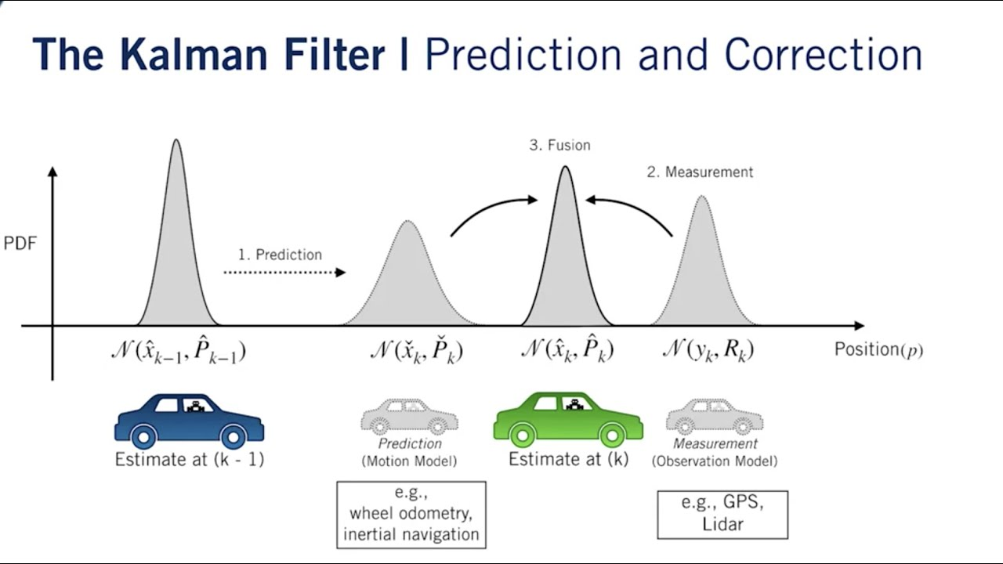
2. Track one obstacle with ADS-B
Use Kalman Filter for prediction and updating the state of the tracking obstacle.

Slide 14
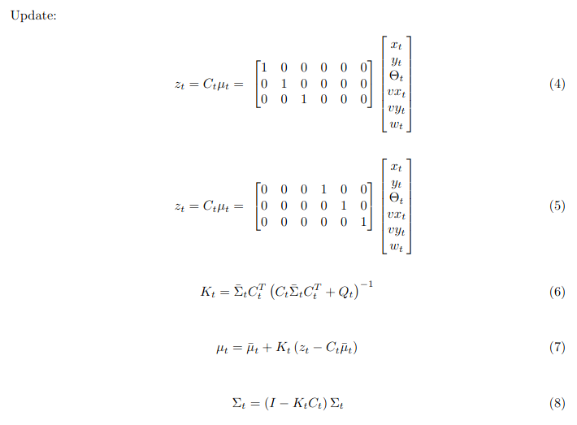
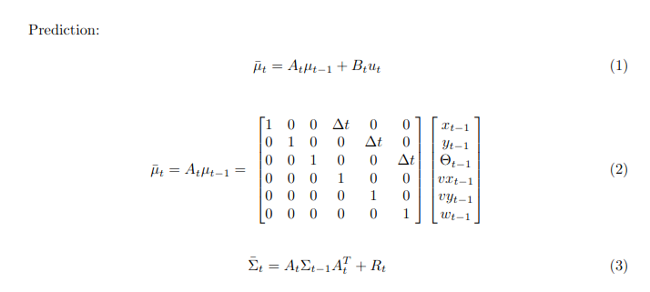
2. Track one obstacle with ADS-B
Design the equation model for the prediction and update of the system.
Example:
State need to use:
Position:
X
Y
Z
Orientation:
X
Y
Z
W
Velocity:
X
Y
Z
Dimensions:
Width
Length
Height

Slide 15
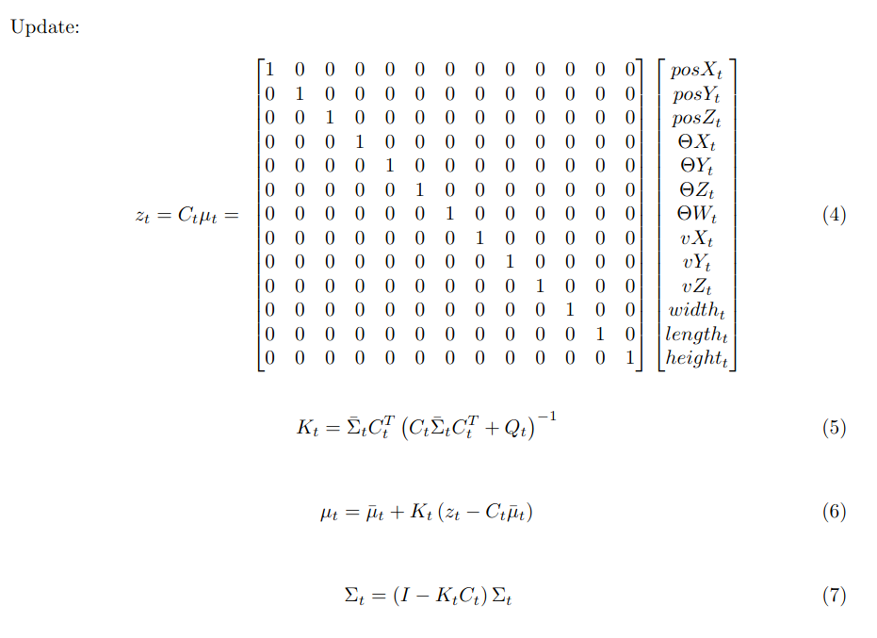
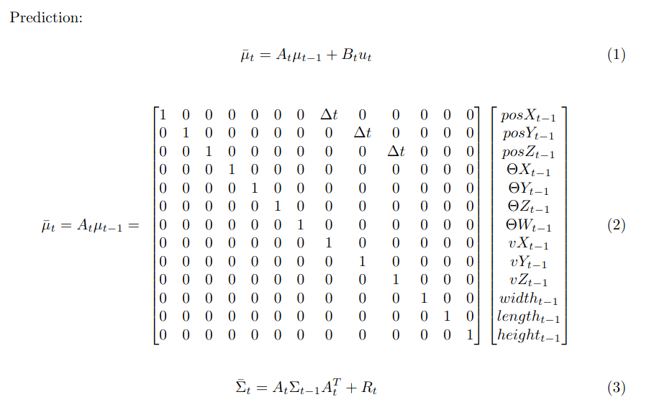
2. Track one obstacle with ADS-B
Simple state prediction and update model for the tracking:
State need to use:
Position:
X
Y
Z
Orientation:
X
Y
Z
W
Velocity:
X
Y
Z
Dimensions:
Width
Length
Height

Slide 16
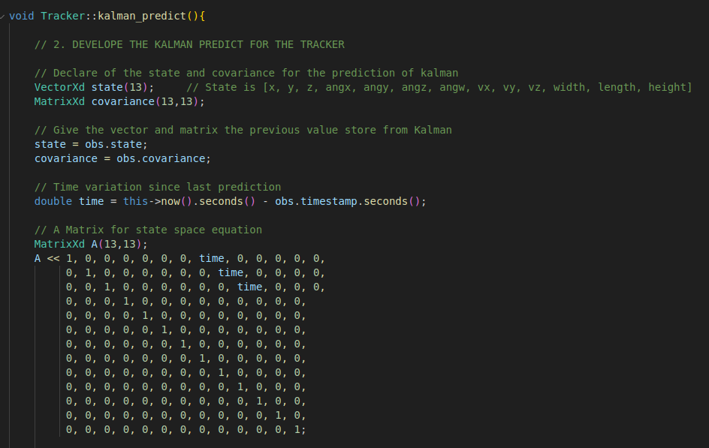
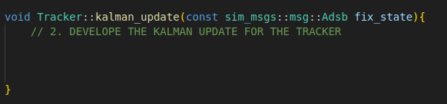
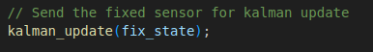
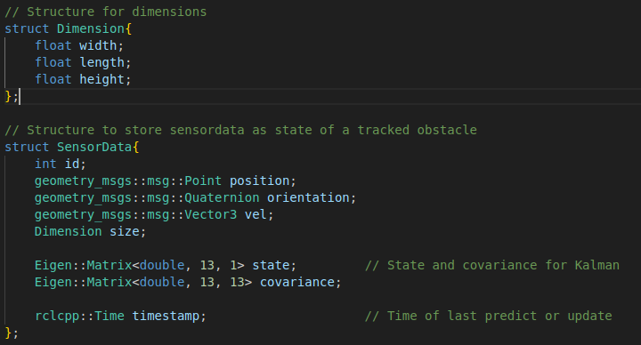
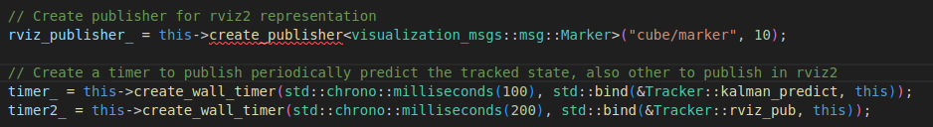
2. Track one obstacle with ADS-B
Now to implement in the code and show in rviz
Ask for any question or error !!!

Slide 17
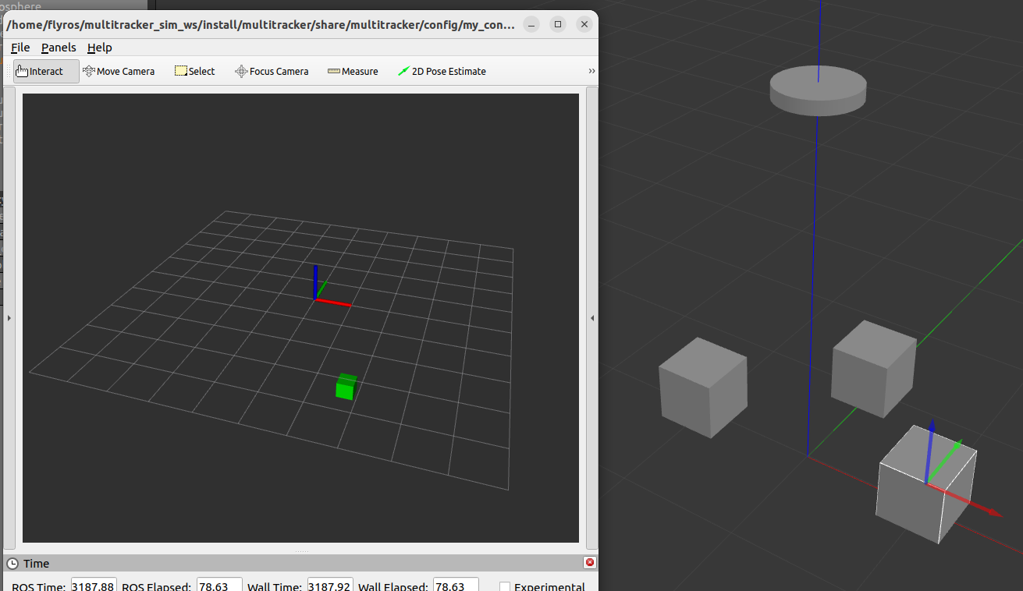
2. Track one obstacle with ADS-B - Solution
GitHub:
https://github.com/Javgilavi/multitracker_sim_ws Branch: one_ais
Ask for any question or error !!!
LET’S SEE RESULT IN RVIZ!!!

Slide 18
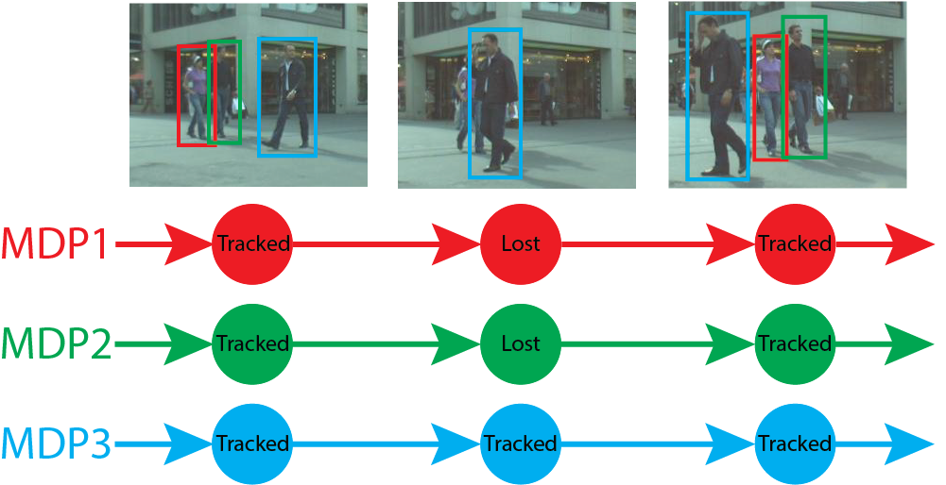
3. Track multiple obstacles with a list
Next step is to be able to track multiples obstacles.
Difficult because of the necessity of a matching system.
With ADS-B we already have ID for each obstacle -> No match needed
Instead of a SensorData obs, we’ll use a vector of SensorData obs_list
RVIZ2 -> MarkerArray instead of Marker
GOAL -> Track the 3 cubes independently at all time with ASD-B data

Slide 19

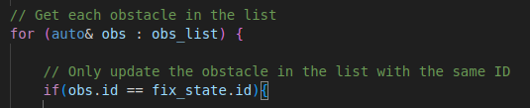
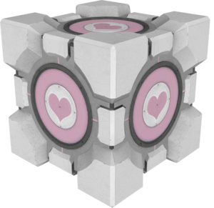
3. Track multiple obstacles with a list
Hints for the code:
Now let’s try to make it by yourselves!!!!
PD: In kalman update now is needed to create obstacle in the list when ID doesn’t match.
Ask for any question or error !!!

Slide 20
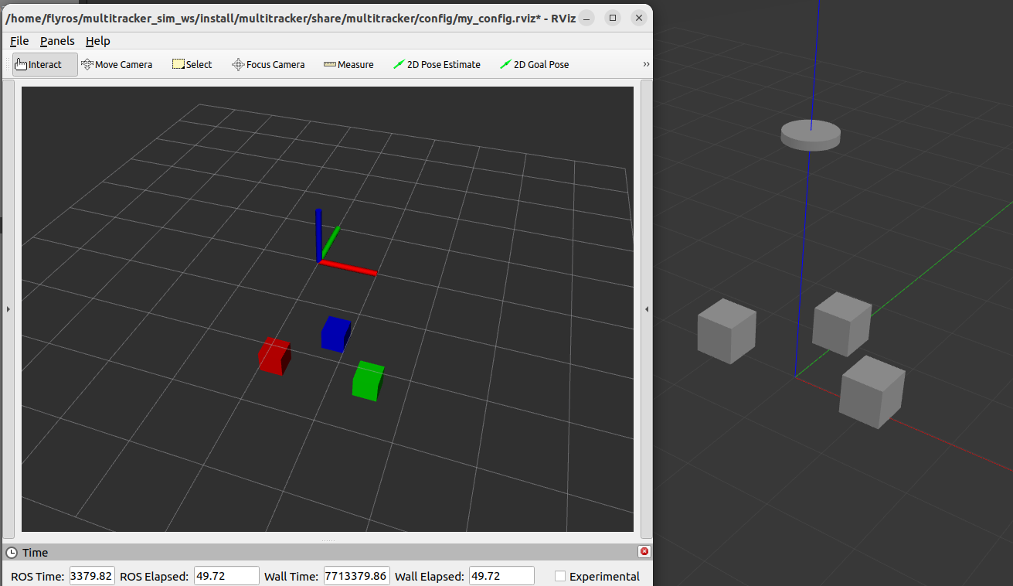
3. Track multiple obstacles with a list - Solution
GitHub:
https://github.com/Javgilavi/multitracker_sim_ws Branch: list_ais
Ask for any question or error !!!
LET’S SEE RESULT IN RVIZ!!!

Slide 21
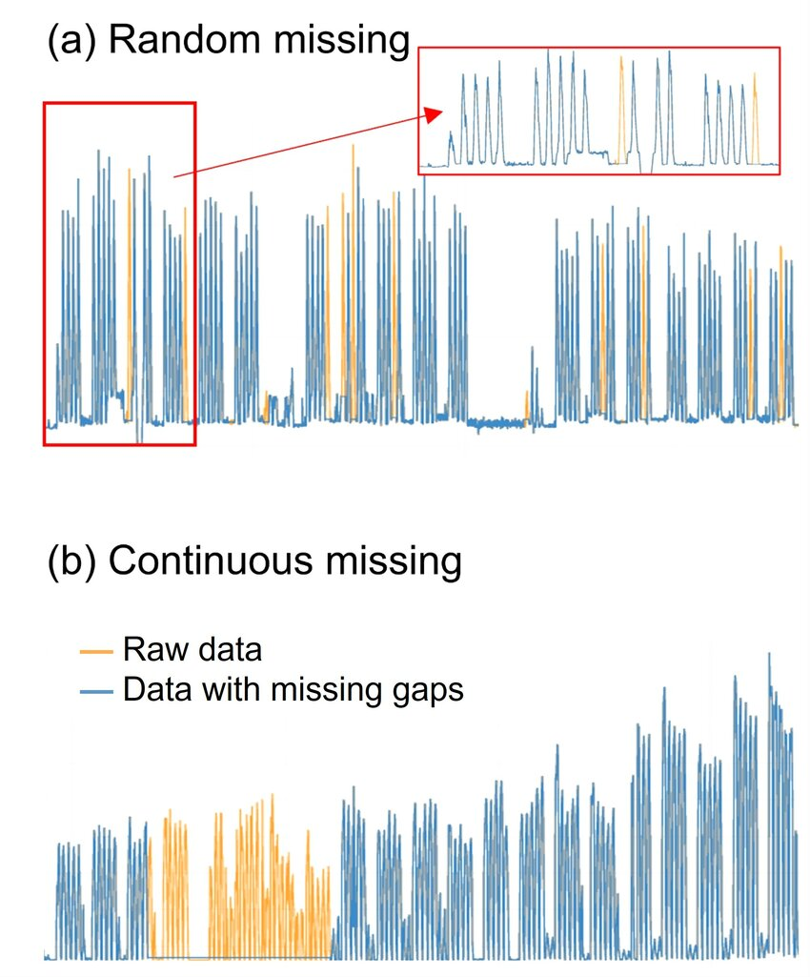

4. System strengthening
What weakness does our system have right now?
What can be upgraded?
Did we “simulate” enough noise?
What happens if an obstacle disappears?
What happens if ADS-B stops giving information for X seconds?
How accurate is the estimation? And the prediction?

Slide 22
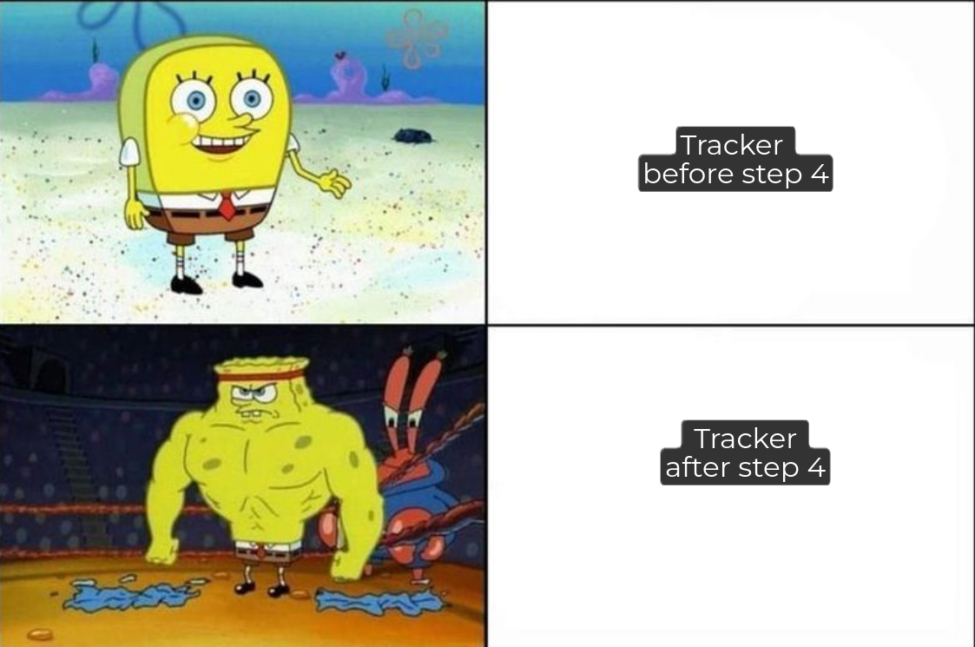
4. System strengthening
What weakness does our system have right now?
What can be upgrade?
We “simulate” enough noise?
What happen if an entity disappear?
What happen if ADS-B stop giving information for X seconds?
How much precise is our system? And the prediction?

Slide 23

4. System strengthening
Brainstorming!!!!!!

Slide 24
4. System strengthening
My ideas:
Delete obstacle from the list after 5s without updating.
After 30s to 50s one cube doesn’t give ADS-B and we make sure it disappears and appear again.
Randomly the ADS-B wouldn’t give data and find how good is our model.
Adjust R matrix in prediction and update for better results.
If wanted, add white noise to the ADS-B data income to test more the model.
Low-pass filter
Try your ideas for strengthening.
GitHub:
https://github.com/Javgilavi/multitracker_sim_ws Branch: list_ais2
Ask for any question or error !!!

Slide 25
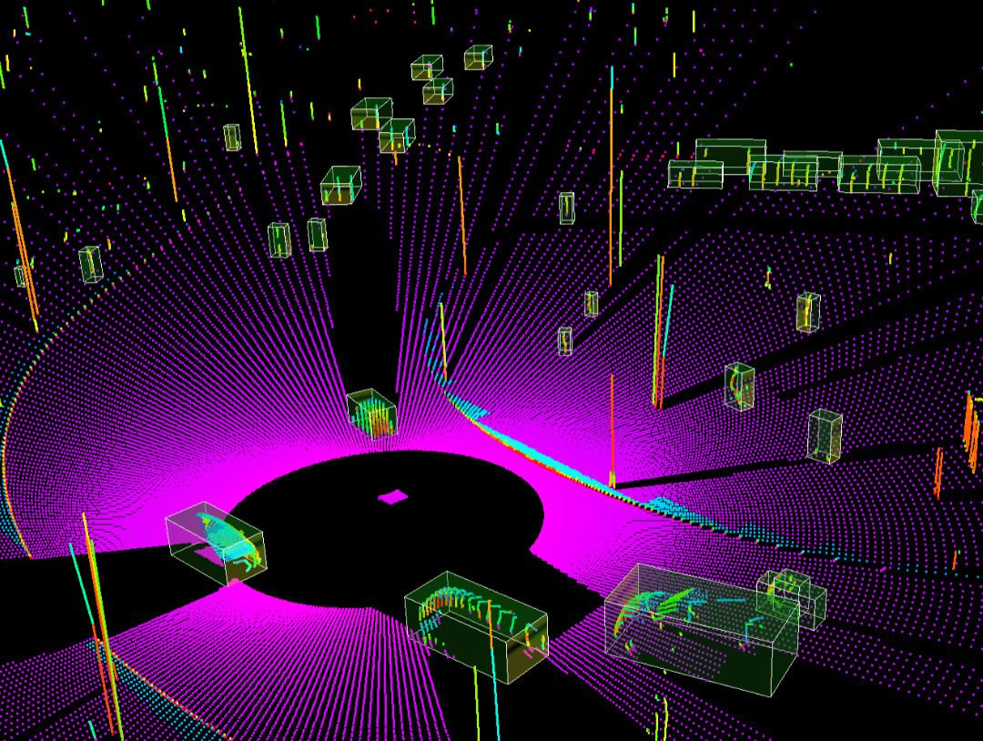
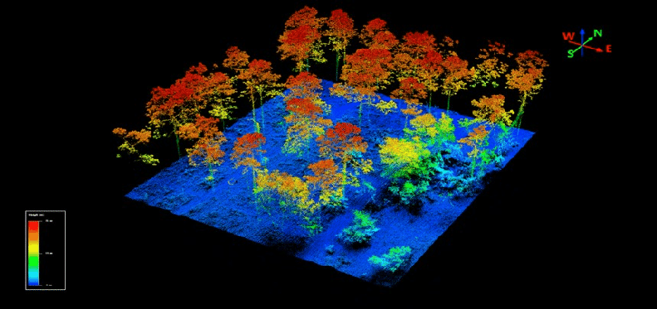
5. Adding LIDAR to the tracker
After having a basic tracker, next step is to fuse different sensors data.
By using data from different sensors, we leverage each one's strengths and minimize their weaknesses.
LiDAR sensors give us a cloud of 3D point of everything that surround us.

Slide 26
5. Adding LIDAR to the tracker
Let’s add it to the simulation:
Open drone_sim project and inside launch/ open “drone_worl_launch.py”
In line 15 change “model.sdf” for “model_lidar.sdf”
After that launch the simulator as before will also create topic to receive the pointcloud. The topic is “drone/laser/scan”

Slide 27
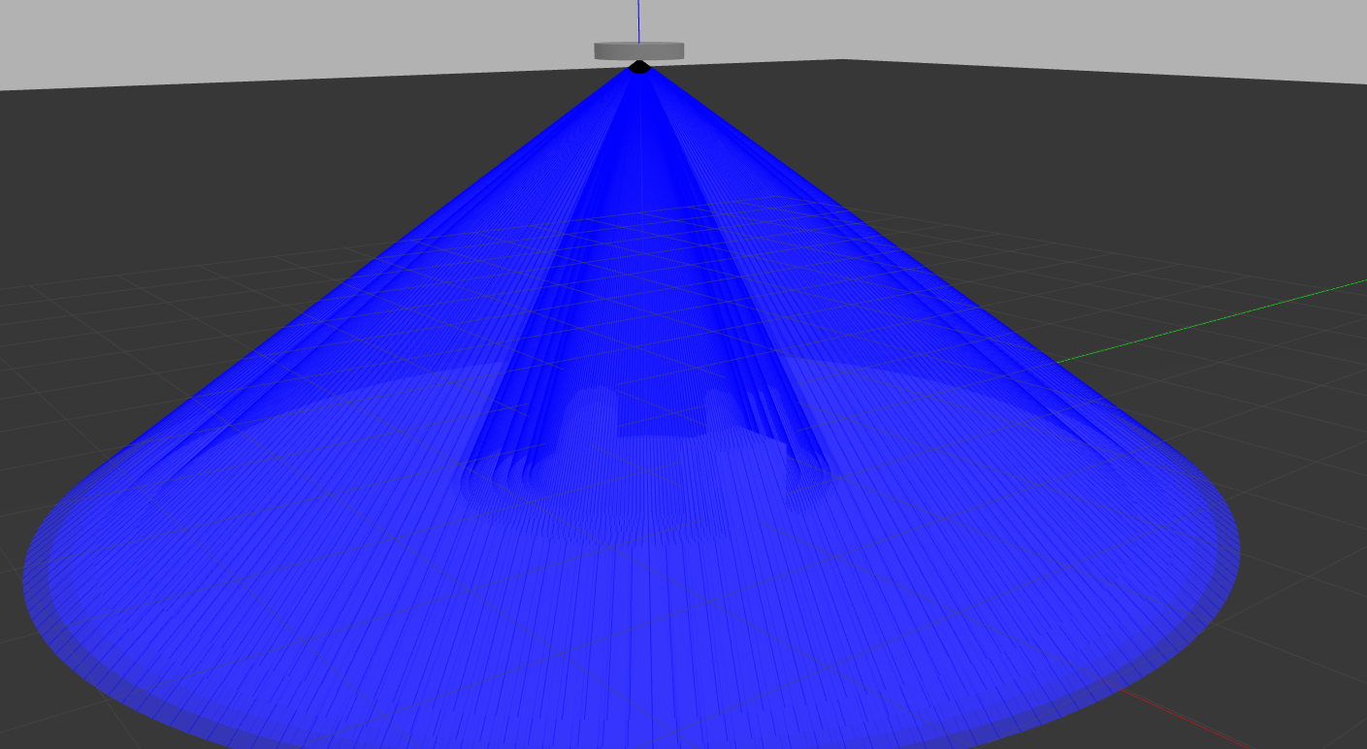
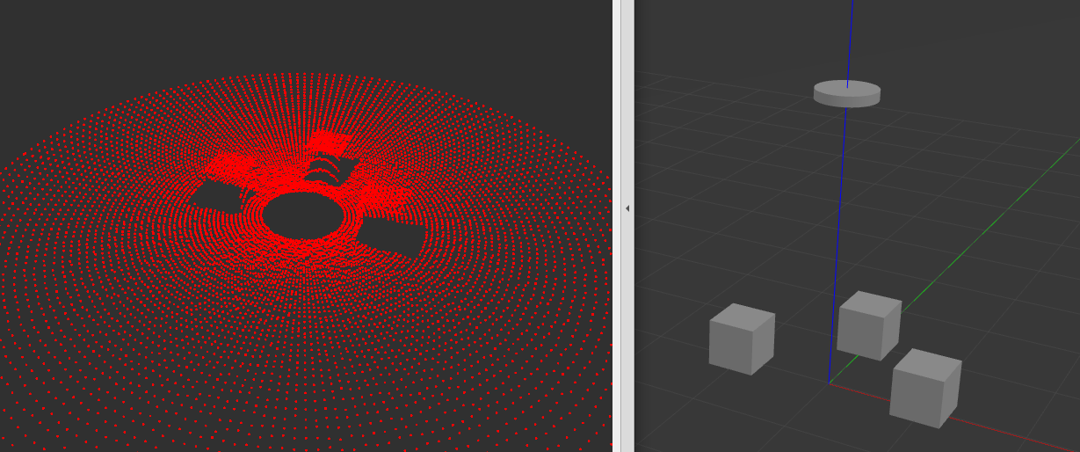
5. Adding LIDAR to the tracker
After that launching the simulator normal will also create a topic to receive the pointcloud. The topic is “drone/laser/scan”

Slide 28
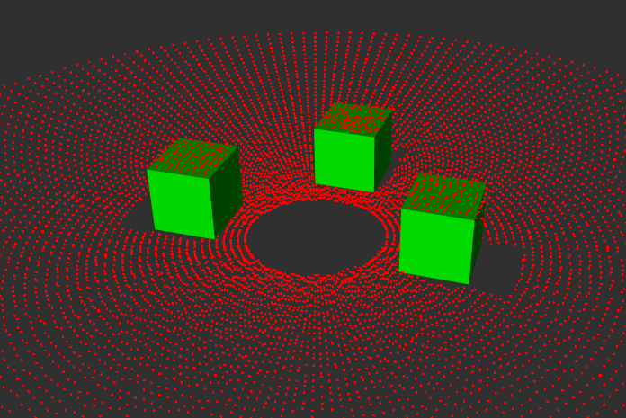
5. Adding LIDAR to the tracker
We can’t add the PointCloud data of the LiDAR directly to the tracker.
For that task a driver of the LiDAR has been developed.
Transform from PointCloud to a vector of Traces.

Slide 29
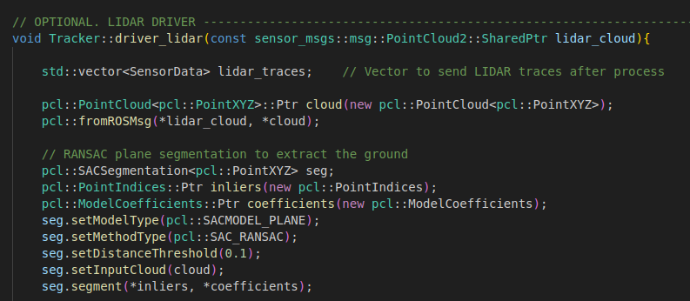
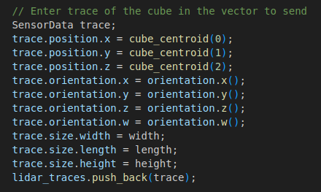
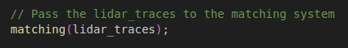
5. Adding LIDAR to the tracker
If someone has any question or want to know how the driver works, just ask it.
GitHub:
https://github.com/Javgilavi/multitracker_sim_ws Branch: bones_lidar
Ask for any question or error !!!

Slide 30
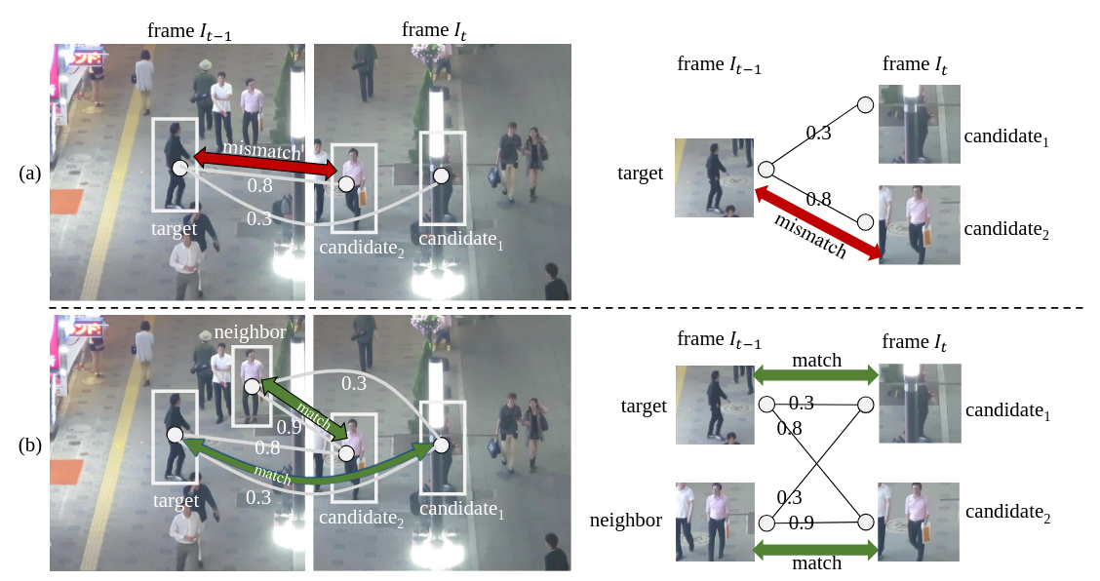
6. Matching of LIDAR tracks
Time for the logic of matching the LIDAR traces with the already tracked obstacle list.
NeighborTrack: Improving Single Object Tracking by Bipartite Matching with Neighbor Tracklets
Yu-Hsi Chen et al

Slide 31
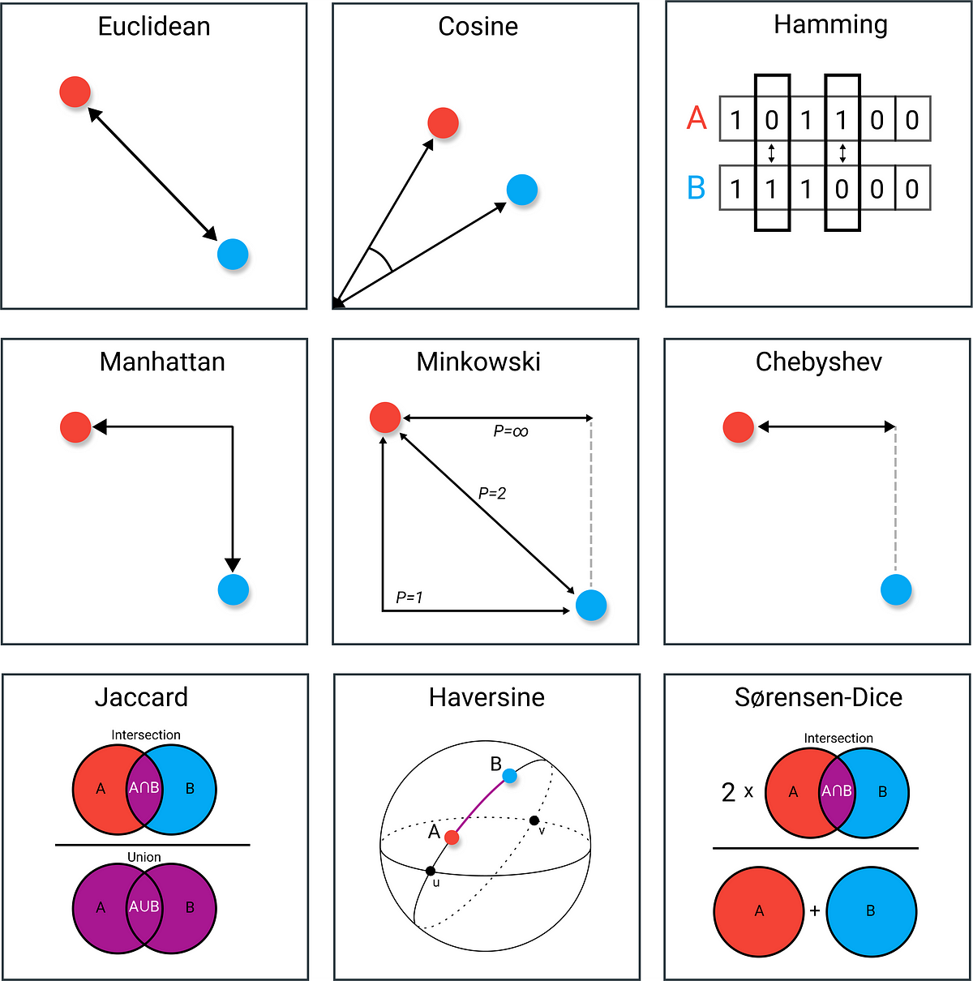
6. Matching of LIDAR tracks
Use of euclidean position (xyz) distance.
But other distances can be used to upgrade the quality of the matches.
Best distance -> less mismatches -> better tracking

Slide 32
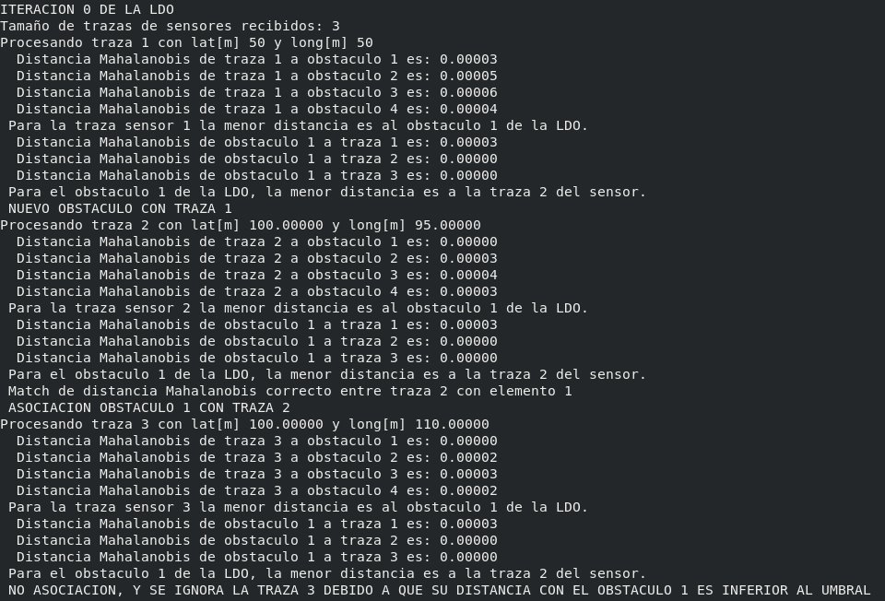
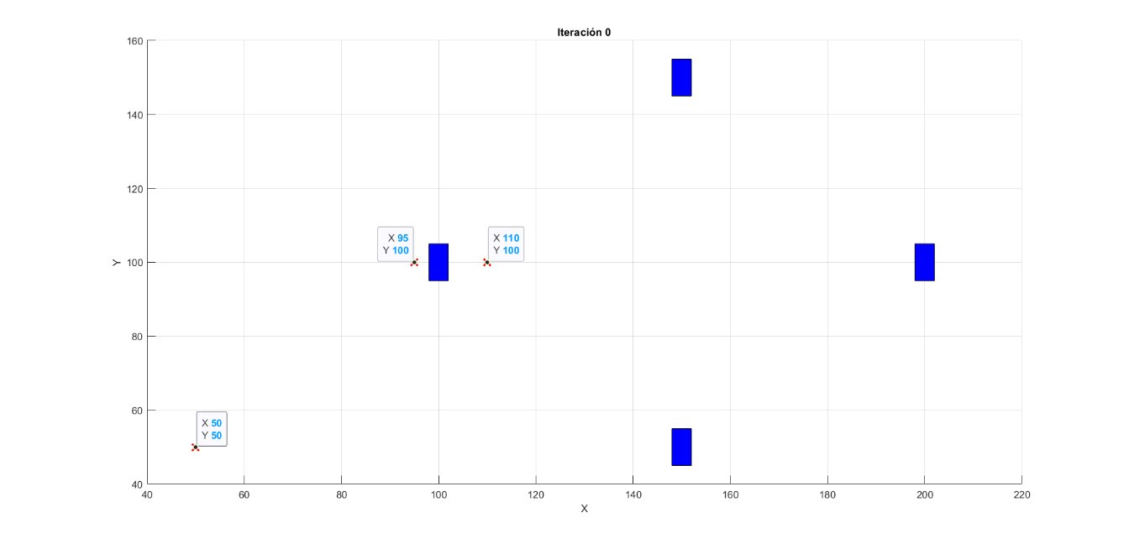
6. Matching of LIDAR tracks
We’ll use double distance check for matching between LiDAR trace and obstacles from the list to be sure the match selected is the best option.

Slide 33
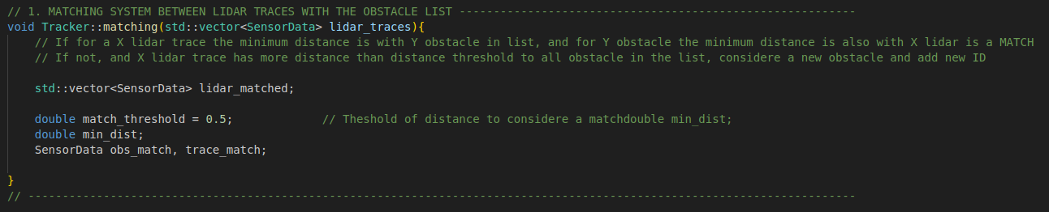
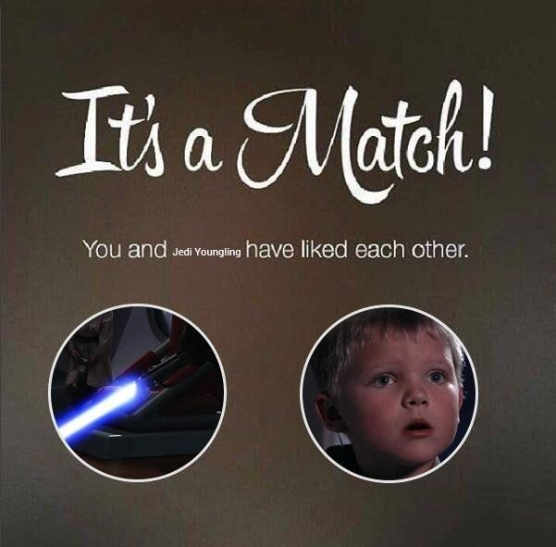
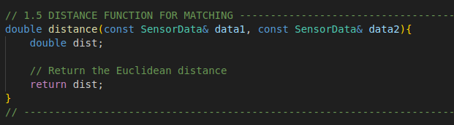
6. Matching of LIDAR tracks
Code time.
Ask for any question or error !!!

Slide 34
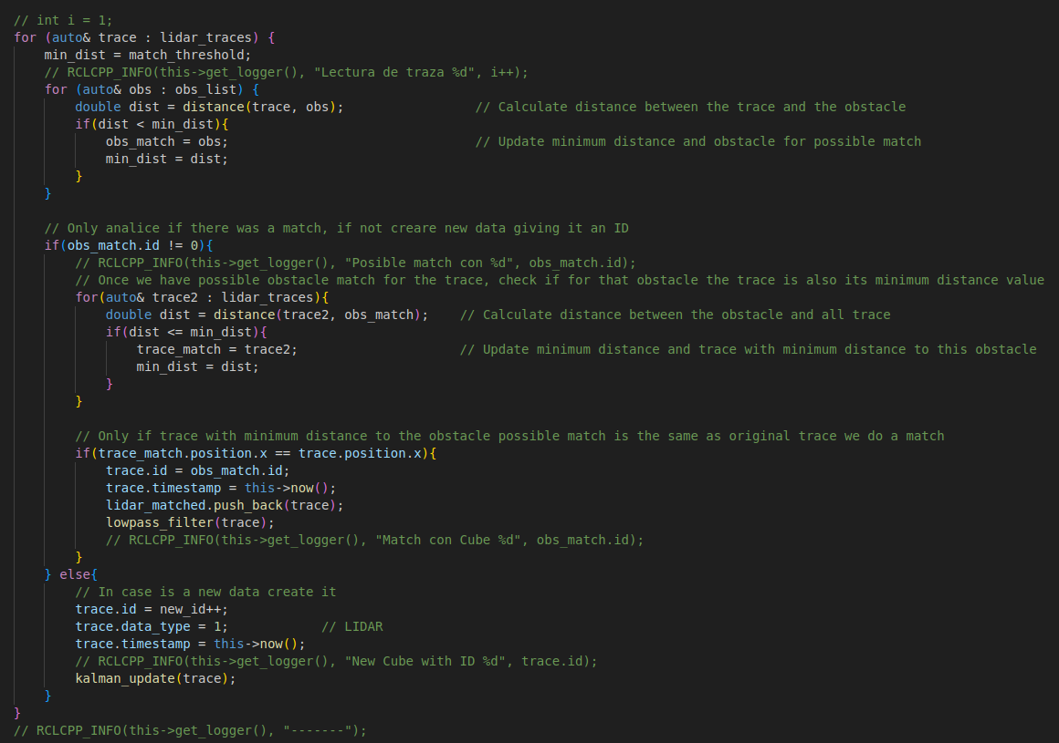
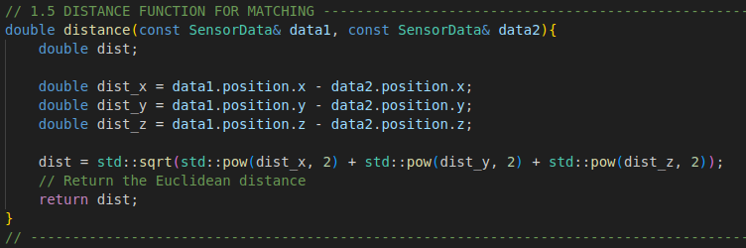
6. Matching of LIDAR tracks - Solution
GitHub:
https://github.com/Javgilavi/multitracker_sim_ws Branch: lidar_match
Ask for any question or error !!!

Slide 35
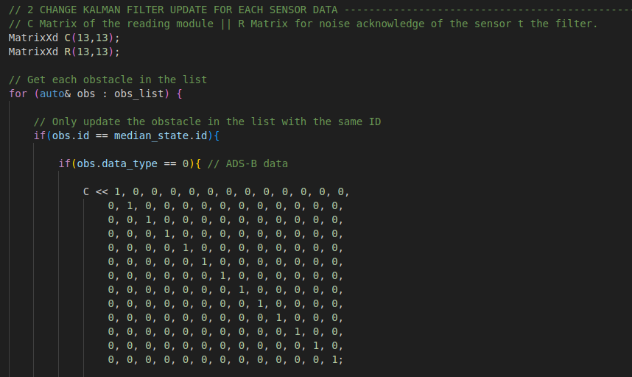
7. Remap Kalman Filter for LIDAR
Easy step
Adding LiDAR traces after match and low-pass filter to kalman update.
For that we’ll change matrices in funcion of ADS-B or LiDAR data.
What should the Kalman matrices for LiDAR be?

Slide 36
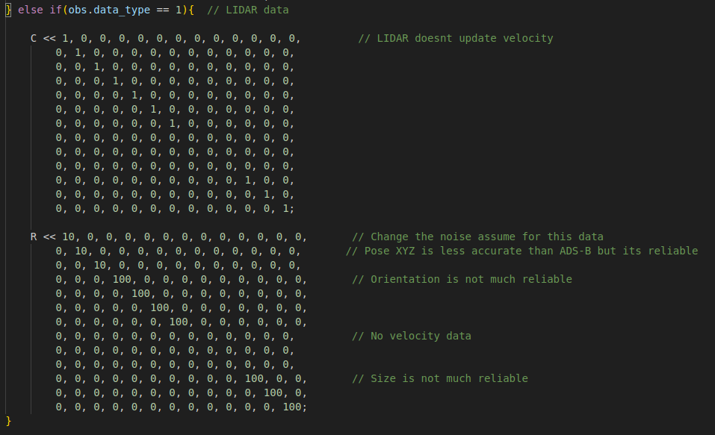
7. Remap Kalman Filter for LIDAR - Solution
GitHub:
https://github.com/Javgilavi/multitracker_sim_ws Branch: lidar
Ask for any question or error !!!

Slide 37
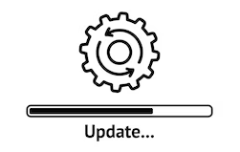
8. Upgrades and debugging
What more upgrades can we make?
Change distance to a better model.
Estimating velocity from LiDAR traces.
Tune the threshold of matching and R matrices for ADS-B and LiDAR.
…

Slide 38
Conclusions
Acquire knowledge on tracking, matching, and sensor data fusion.
Leave with a simple multi-sensor, multi-obstacle tracking system for your use.
You can further develop it to a higher level if you wish.
Apply it to real-world scenarios based on your needs.
Explore further improvements and research opportunities related to it.
…

Slide 39

Conclusions
Now you have the power…

Slide 40
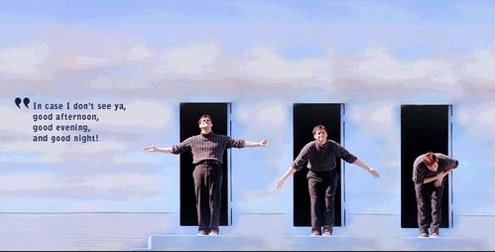
Thanks for your Attention!!!

